Slide 1
Week 3
Alexey V. Zimin
JHU BME 580.417

Slide 2
Lab 2: Minimizers
DUE Friday September 25 at 8:00pm
Q1. CODE (100% undergrad, 90% grad): Write four python functions to compute minimizers and implied alignments for a genomic sequence:
  reverse_complement(seq): returns reverse complement of a sequence seq
  compute_num_value(seq): returns numerical value of sequence seq (A=0,C=1,G=2,T=3), base 4 starting with the first letter. For each k-mer compute numerical value forward and reverse, use minimum
  compute_minimizers(seq,k,w): computes minimizers for sequence seq, k-mer k, and window w, returns a tuple of arrays containing 0-based leftmost position of each minimizer, and minimizer values
  compute_implied_alignments(seq1,seq2,k,w): computes implied alignments based on minimizer positions. Seq1 is always forward, seq2 could be forward or reverse. Returns tuple of arrays corresponding to implied offsets between seq1 and seq2 and implied orientations (-1 or 1):
  AGATAGACC
  ATAGACCAT -- offset=2, orientation 1
  AGATAGACC
  AGGTCTATCTT -- offset=-1, orientation -1
  Submit code through autograder, name code minimizers.py
Q2. FIGURE (10% graduate students ONLY):
  Generate random sequence G 100,000 bp long
  Assume K=17, vary w from 1 to 16
  How does the number of minimizers N vary with w?
  Submit plot of N(w) – graduate students only, pdf, png or jpeg format, use log scale on y axis

Slide 3
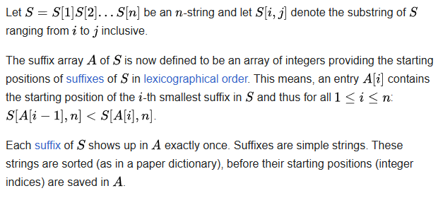
Data Structure: Suffix Array
Introduced by Manber & Myers (1990)
Cost to build: O(n² log n), cost to look up: O(m+log n), where m is the length of the query sequence and n is the length of the reference

Slide 4
Building a suffix array
Genome string TAGCAATG$
  $ denotes the end of the string
Suffixes:
0 TAGCAATG$
1 AGCAATG$
2 GCAATG$
3 CAATG$
4 AATG$
5 ATG$
6 TG$
7 G$
8 $

Slide 5
Building a suffix array
Lexicographic order: $<A<C<G<T
Sort suffixes, record indices in an array:
8 $
4 AATG$
1 AGCAATG$
5 ATG$
3 CAATG$
7 G$
2 GCAATG$
0 TAGCAATG$
6 TG$
We cannot afford to store all these subsequences! Store just the indices!

Slide 6
Looking up in suffix array
Query sequence: GCAA
Binary search of the array, first look for strings starting with a G:
Hi-> 8 $
4 AATG$
1 AGCAATG$
5 ATG$
Starts with a G? -> 3 CAATG$
7 G$
2 GCAATG$
0 TAGCAATG$
Lo-> 6 TG$

Slide 7
Looking up in suffix array
Query sequence: GCAA
When a match is found, go up and down to find all matching positions:
8 $
4 AATG$
1 AGCAATG$
5 ATG$
Hi-> 3 CAATG$
7 G$
Starts with a G? -> 2 GCAATG$
0 TAGCAATG$
Lo-> 6 TG$

Slide 8
Looking up in suffix array
Query sequence: GCAA
When a match is found, go up and down to find all matching positions :
8 $
4 AATG$
1 AGCAATG$
5 ATG$
3 CAATG$
Hi -> Starts w GC? 7 G$
Lo -> Starts w GC? 2 GCAATG$
0 TAGCAATG$
6 TG$

Slide 9
Looking up in suffix array
Query sequence: GCAA
Found a perfect match:
8 $
4 AATG$
1 AGCAATG$
5 ATG$
3 CAATG$
7 G$
Perfect match 2 GCAATG$
0 TAGCAATG$
6 TG$

Slide 10
Looking up in suffix array
Found a perfect match or unable to find longer match
When a match is found, go up and down to find all matching positions:
8 $
4 AATG$
1 AGCAATG$
5 ATG$
3 CAATG$
7 G$
Perfect match 2 GCAATG$
0 TAGCAATG$
6 TG$

Slide 11
Perfect and imperfect matches
String match:
TAGCAATG$
GCAA at position 2
What about imperfect matches , e.g. GCAT?

Slide 12
Looking up in suffix array
Query sequence: GCAT
Found a partial match – is it long enough to keep?:
8 $
4 AATG$
1 AGCAATG$
5 ATG$
3 CAATG$
7 G$
Partial match 2 GCAATG$
0 TAGCAATG$
6 TG$

Slide 13
Example of alignment of two sequences
Start at the beginning of the query, find the longest match(es)
  Indexed reference
  GCCCATGACTCGCATGCTGACATGCTGCTAGCT
  Query
  TCGCATGCTTCATGGTGCTTGCTA

Slide 14
Alignment of two sequences
Start at the beginning of the query, find the longest match(es)
  Indexed reference
  GCCCATGACTCGCATGCTGACATGCTGCTAGCT
  TCGCATGCTTCATGGTGCTAGCTA

Slide 15
Alignment of two sequences
Start at the beginning of the query, find the longest match(es)
  Indexed reference
  GCCCATGACTCGCATGCTGACATGCTGCTAGCT
  TCGCATGCTTCATGGTGCTAGCTA

Slide 16
Alignment of two sequences
Use minimum matching length of 5 to avoid repetitive matches
  Indexed reference
  GCCCATGACTCGCATGCTGACATGCTGCTAGCT
  TCGCATGCTTCATGGTGCTAGCTA

Slide 17
Alignment of two sequences
Use minimum matching length of 5 to avoid repetitive matches
  Indexed reference
  GCCCATGACTCGCATGCTGACATGCTGCTAGCT
  TCGCATGCTTCATGGTGCTAGCTA

Slide 18
Alignment of two sequences
Do Smith-Waterman between the matching seeds
  Indexed reference
  GCCCATGACTCGCATGCTGACATGCTGCTAGCT
  ||||||||| |||| ||||||||
  TCGCATGCTT-CATGGTGCTAGCTA
Compute alignment score based on Smith-Waterman alignment

Slide 19
Burrows-Wheeler Transform
Burrows-Wheeler Transform (BWT) is used to create efficient index of a sequence compared to just using the suffix array
BWT rearranges a character string into runs of similar characters, in a manner that can be reversed to recover the original string.
Used in bzip2 compression algorithm
Pairs with suffix array to create an efficient index into genome sequence

Slide 20
Burrows-Wheeler Transform
Example: BANANA$
All rotations:
0 BANANA$
1 ANANA$B
2 NANA$BA
3 ANA$BAN
4 NA$BANA
5 A$BANAN
6 $BANANA
Sort in lexicographic order:
6 $BANANA
5 A$BANAN
3 ANA$BAN
1 ANANA$B
0 BANANA$
4 NA$BANA
2 NANA$BA

Slide 21
Burrows-Wheeler Transform
Example: BANANA$
All rotations:
0 BANANA$
1 ANANA$B
2 NANA$BA
3 ANA$BAN
4 NA$BANA
5 A$BANAN
6 $BANANA
Sort in lexicographic order:
6 $BANAN A
5 A$BANA N
3 ANA$BA N
1 ANANA$ B
0 BANANA $
4 NA$BAN A
2 NANA$B A
Suffix Array:
6 5 3 1 0 4 2
BWT:
ANNB$AA

Slide 22
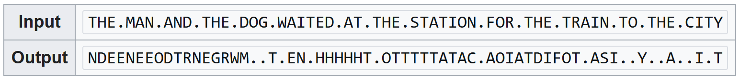
BWT rationale
If the original string had several substrings that occurred often, then the BWT-transformed string will have several places where a single character is repeated many times in a row, creating more-easily-compressible data.
Example:

Slide 23
BWT reversibility
A
N
N
B
$
A
A
$A
A
A
BN
N
A$
NA
NA
BA
$B
AN
AN
$B
A$
AN
AN
BA
NA
NA
A$B
NA$
NAN
BAN
$BA
ANA
ANA
$BA
A$B
ANA
ANA
BAN
NA$
NAN
A$BA
NA$B
NANA
BANA
$BAN
ANA$
ANAN
Sort
Add
Sort
Add
Sort
Add

Slide 24
BWT reversibility
A$BA
NA$B
NANA
BANA
$BAN
ANA$
ANAN
$BAN
A$BA
ANA$
ANAN
BANA
NA$B
NANA
A$BAN
NA$BA
NANA$
BANAN
$BANA
ANA$B
ANANA
$BANA
A$BAN
ANA$B
ANANA
BANAN
NA$BA
NANA$
A$BANA
NA$BAN
NANA$B
BANANA
$BANAN
ANA$BA
ANANA$
$BANAN
A$BANA
ANA$BA
ANANA$
BANANA
NA$BAN
NANA$B
Sort
Add
Sort
Add
Sort

Slide 25
BWT reversibility
A$BANAN
NA$BANA
NANA$BA
BANANA$
$BANANA
ANA$BAN
ANANA$B
$BANANA
A$BANAN
ANA$BAN
ANANA$B
BANANA$
NA$BANA
NANA$BA
Add
Sort

Slide 26
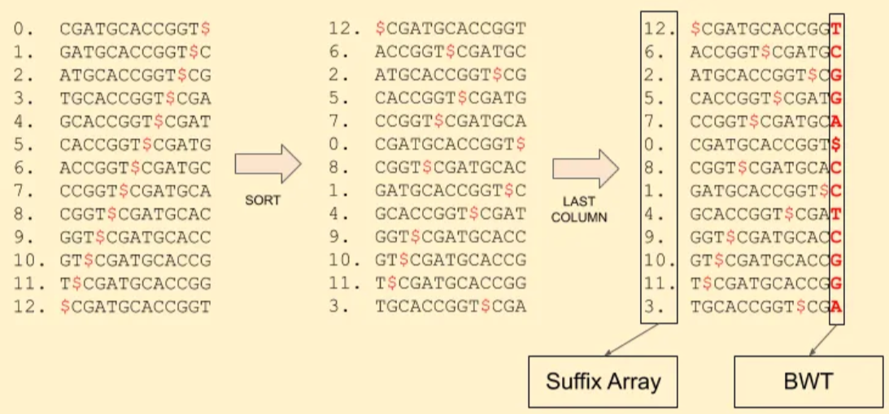
Using BWT and SA for sequence alignments
Reference sequence: CGATGCACCGGT:

Slide 27
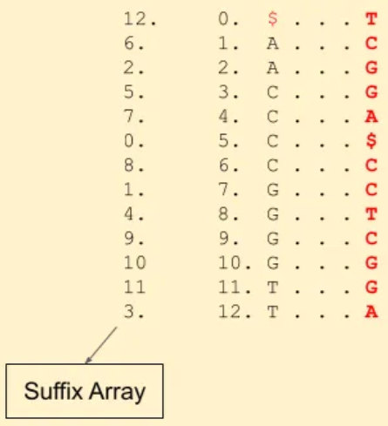
Using BWT and SA for sequence alignments
Reference sequence: CGATGCACCGGT,
Match read TGCA
Start at the end, look for A’s in the SA
Find which of the A’s are followed by C -- 1st
C in the BWT, look at the 1st C in the SA

Slide 28
Using BWT and SA for sequence alignments
Reference sequence: CGATGCACCGGT,
Match read TGCA
Start at the end, look for A’s in the SA
Find which of the A’s are followed by C -- 1st
C in the BWT, look at the 1st C in the SA
Is that C followed by a G -- yes, 2nd G in the BWT

Slide 29
Using BWT and SA for sequence alignments
Reference sequence: CGATGCACCGGT,
Match read TGCA
Start at the end, look for A’s in the SA
Find which of the A’s are followed by C -- 1st
C in the BWT, look at the 1st C in the SA
Is that C followed by a G -- yes, 2nd G in the BWT
Is the G followed by a T -- yes, 2nd T in the BWT

Slide 30
Using BWT and SA for sequence alignments
Reference sequence: CGATGCACCGGT,
Match read TGCA
Start at the end, look for A’s in the SA
Find which of the A’s are followed by C -- 1st
C in the BWT, look at the 1st C in the SA
Is that C followed by a G -- yes, 2nd G in the BWT
Is the G followed by a T -- yes, 2nd T in the BWT

Slide 31
Using BWT and SA for sequence alignments
Reference sequence: CGATGCACCGGT,
Match read TGCA
Start at the end, look for A’s in the SA
Find which of the A’s are followed by C -- 1st
C in the BWT, look at the 1st C in the SA
Is that C followed by a G -- yes, 2nd G in the BWT
Is the G followed by a T -- yes, 2nd T in the BWT
The SA index of that T is 3!

Slide 32
Save memory with BWT/SA
Storing suffix array indices is expensive!
Do we have to store all of them in BWT/SA? No!
12 $...T
6 A...C
2 A...G
5 C...G
7 C...A
0 C...$
8 C...C
1 G...C
4 G...T
9 G...C
10 G...G
11 T...G
3 T...A

Slide 33
Save memory with BWT/SA
Storing suffix array indices is expensive!
Do we have to store all of them in BWT/SA? No!
12 $...T
6 A...C
2 A...G
5 C...G
7 C...A
0 C...$
8 C...C
1 G...C
4 G...T
9 G...C
10 G...G
11 T...G
3 T...A

Slide 34
Save memory with BWT/SA
Reference sequence: CGATGCACCGGT
Match read ACCG
12 $...T
6 A...C
2 A...G
5 C...G
7 C...A
0 C...$
8 C...C
1 G...C
4 G...T
9 G...C
10 G...G
11 T...G
3 T...A

Slide 35
Save memory with BWT/SA
Reference sequence: CGATGCACCGGT
Match read ACCG
12 $...T
6 A...C
2 A...G
5 C...G
7 C...A
0 C...$
8 C...C
1 G...C
4 G...T
9 G...C
10 G...G
11 T...G
3 T...A

Slide 36
Save memory with BWT/SA
Reference sequence: CGATGCACCGGT
Match read ACCG
12 $...T
6 A...C
2 A...G
5 C...G
7 C...A
0 C...$
8 C...C
1 G...C
4 G...T
9 G...C
10 G...G
11 T...G
3 T...A

Slide 37
Save memory with BWT/SA
Reference sequence: CGATGCACCGGT
Match read ACCG
12 $...T
6 A...C
2 A...G
5 C...G
7 C...A
0 C...$
8 C...C
1 G...C
4 G...T
9 G...C
10 G...G
11 T...G
3 T...A

Slide 38
Save memory with BWT/SA
Reference sequence: CGATGCACCGGT
Match read ACCG
Not stored? Keep going
12 $...T
6 A...C
2 A...G
5 C...G
7 C...A
0 C...$
8 C...C
1 G...C
4 G...T
9 G...C
10 G...G
11 T...G
3 T...A

Slide 39
Save memory with BWT/SA
Reference sequence: CGATGCACCGGT
Match read ACCG
Not stored? Keep going 1
12 $...T
6 A...C
2 A...G
5 C...G
7 C...A
0 C...$
8 C...C
1 G...C
4 G...T
9 G...C
10 G...G
11 T...G
3 T...A

Slide 40
Save memory with BWT/SA
Reference sequence: CGATGCACCGGT
Match read ACCG
Not stored? Keep going 2
Got it, the index of G is 4
We made two hops, so the start of ACCG is 4+2=6!
12 $...T
6 A...C
2 A...G
5 C...G
7 C...A
0 C...$
8 C...C
1 G...C
4 G...T
9 G...C
10 G...G
11 T...G
3 T...A

Slide 41
Speed up BWT/SA
In addition to part of the SA, store cumulative sums
12 $...T
6 A...C
2 A...G
5 C...G
7 C...A
0 C...$
8 C...C A(1),C(1),G(2),T(1)
1 G...C
4 G...T
9 G...C
10 G...G
11 T...G
3 T...A

Slide 42
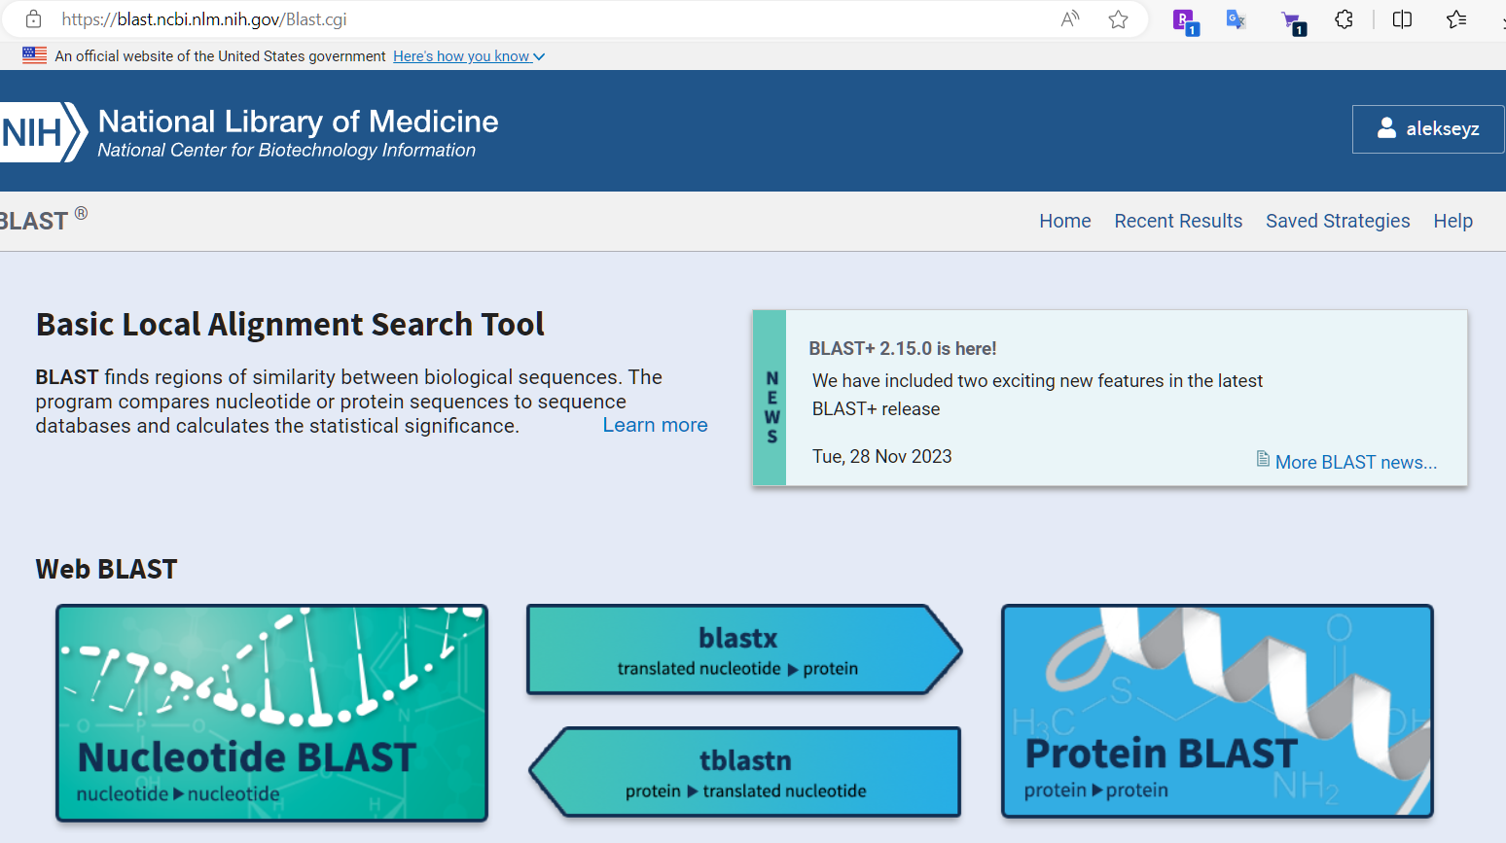
Alignment programs
Key Features of BLAST
Sequence Comparison: BLAST aligns query sequences (DNA, RNA, or protein) with database sequences.
Statistical Significance: It calculates the likelihood that the observed alignment occurred by chance (E-value).
Speed and Efficiency: BLAST uses heuristics, making it faster than traditional alignment algorithms like Smith-Waterman.
How BLAST Works
Seeding: BLAST identifies short, high-scoring K-mers (K=6) in the query sequence.
Extension: It extends these matches in both directions to form longer alignments.
Scoring: Alignments are scored based on substitution matrices (e.g., PAM, BLOSUM for proteins) or nucleotide match/mismatch scores.
Filtering: Low-scoring alignments are discarded, and significant matches are retained.
Blast – suite of aligners developed at NCBI
Online interface, useful for small sequences

Slide 43
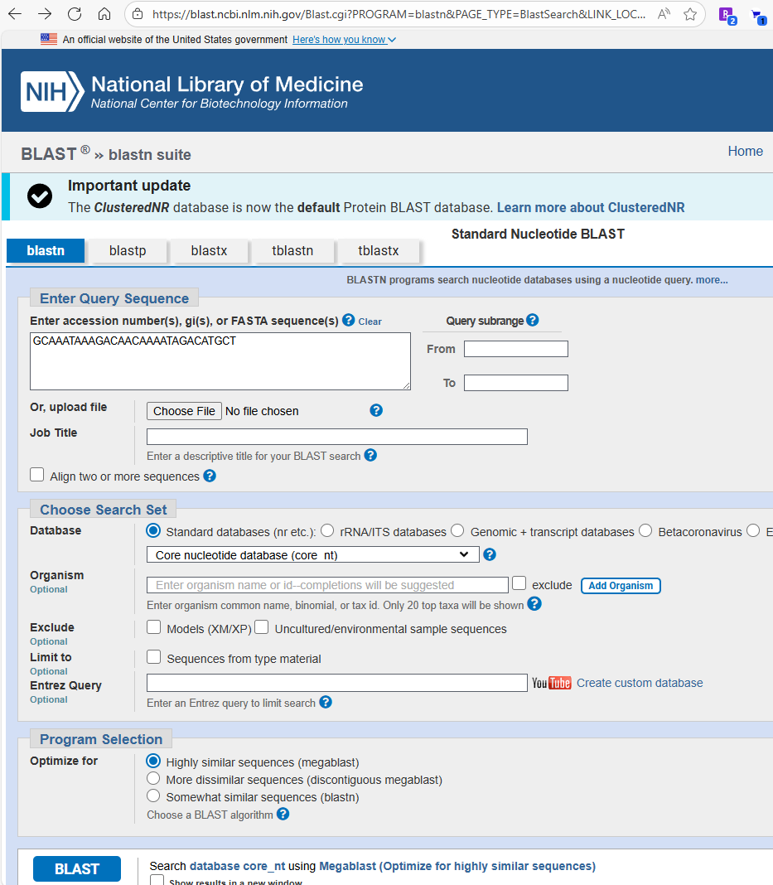
NCBI Blast online
Blastn– genome to genome
Blastp – protein to protein
Blastx – genome(trnsl) to protein
Tblastn – protein to genome (trnsl)
Tblastx -- genome(trnsl) to genome(trnsl)

Slide 44
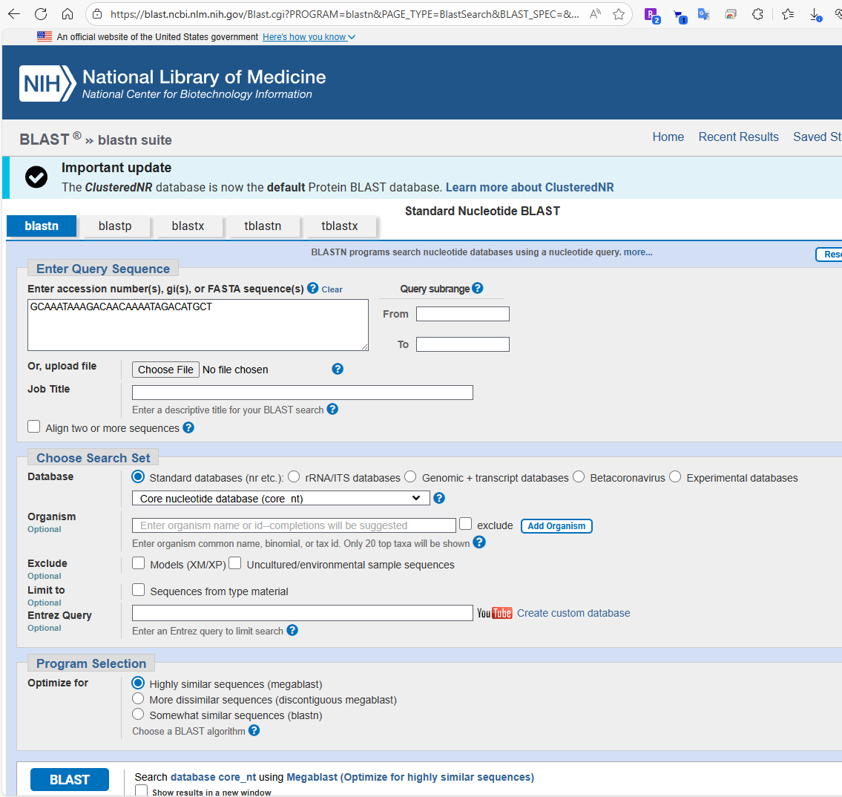
NCBI Blast online

Slide 45
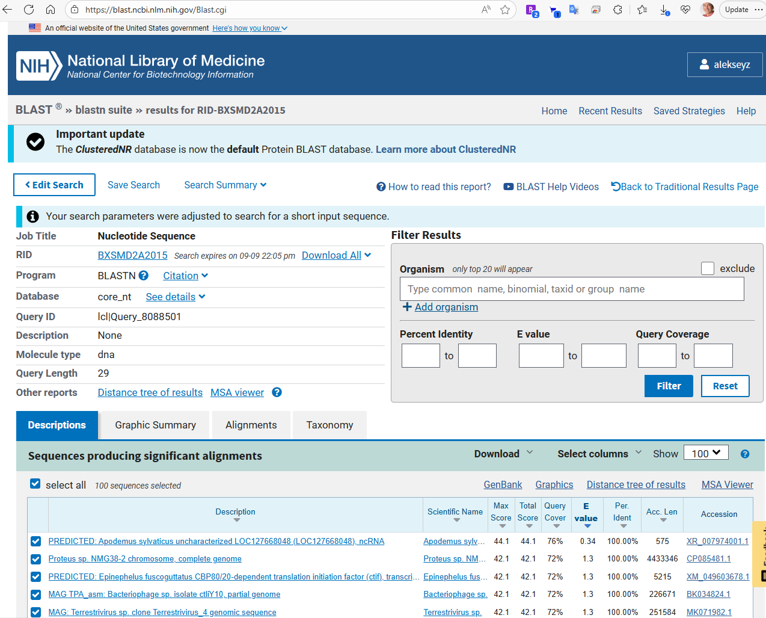
NCBI Blast online

Slide 46

Local blast suite

Slide 47
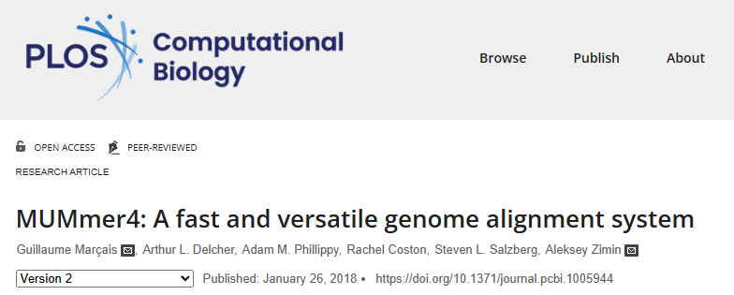
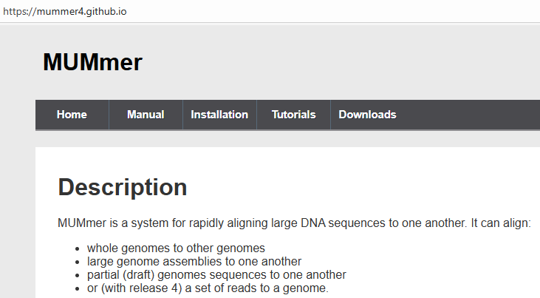
Alignment programs
Nucmer and promer (part of mummer package)
  Used for DNA (nucmer) and protein (promer) sequence alignments
  Based on suffix array, computes index of the reference

Slide 48
Nucmer aligner
nucmer is a general alignment tool for aligning DNA sequences
  documentation https://mummer4.github.io/
fast, multi-threaded
virtually no limitation on sequence length
based on seeding the alignment with maximal exact matches (MUMs) and suffix arrays

Slide 49
Nucmer usage
nucmer –t <# threads> -p <prefix> reference.fa query.fa
output is in prefix.delta (can also output SAM format)
by default only uses seeds (MEMs or MUMs) that are unique in the reference!
Most useful options
  -l minimum match length
  -c minimum length of cluster of exact matches
  --batch load reference in batches

Slide 50
Filtering/viewing nucmer output
delta-filter tool is used to filter the output delta file
show-aligns tool is used to display individual alignments
show-coords tool is used to display the alignment coordinates in human-readable coords format
most useful options
  -l long output format
  -c include percent coverage
  -H remove header
  -r sort alignments by reference coordinate

Slide 51
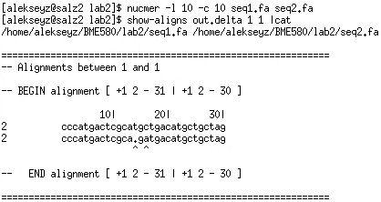
show-aligns output
Alignment:
GCCCATGACTCGCATGCTGACATGCTGCTAGCT
||||||||||||| | |||||||||||||| |
ACCCATGACTCGCA-GATGACATGCTGCTAGAT

Slide 52
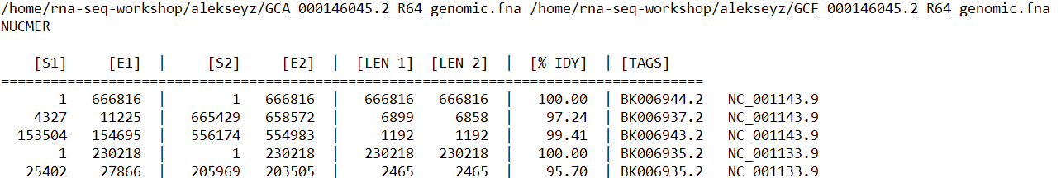
delta/coords format
delta files are produced by nucmer, can be converted to coords format with show-coords
coords format (depends on the options), all 1-based
It is possible to change the format with –l –c –H –r –q switches

Slide 53
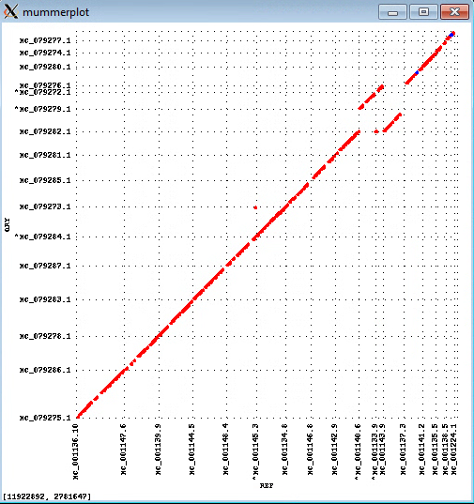

Filtering/viewing nucmer output
Mummerplot command will show the alignments as a plot
Align two strains of yeast (Saccharomyces cerevisiae and Saccharomyces kudriavzevii)

Slide 54
Filtering/viewing nucmer output
Mummerplot command will show the alignments as a plot
Align two strains of yeast (Saccharomyces cerevisiae and Saccharomyces kudriavzevii)

Slide 55
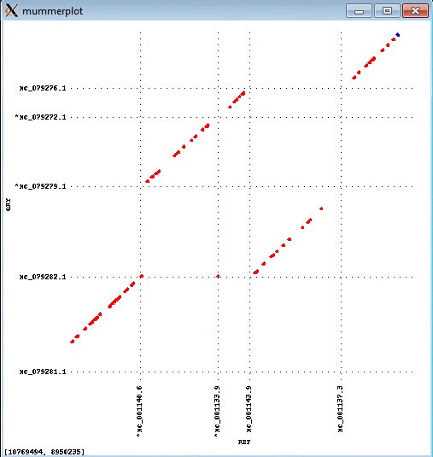
Filtering/viewing nucmer output
Mummerplot command will show the alignments as a plot
Align two strains of yeast (Saccharomyces cerevisiae and Saccharomyces kudriavzevii)

Slide 56
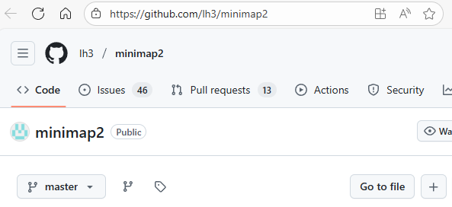
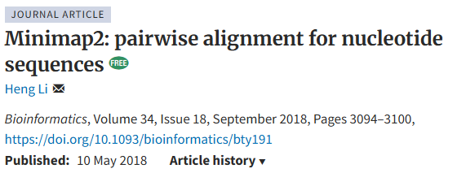
Alignment programs
Minimap2
  based on minimizers

Slide 57
minimap2
minimap2 is a very fast aligner primarily useful for alignment of noisy long reads to the genome
Uses minimizers to seed alignments (k=15, w=10 by default)
Useful undocumented parameter: --secondary=no
Outputs Pairwise mApping Format (PAF) format by default, can output SAM format

Slide 58
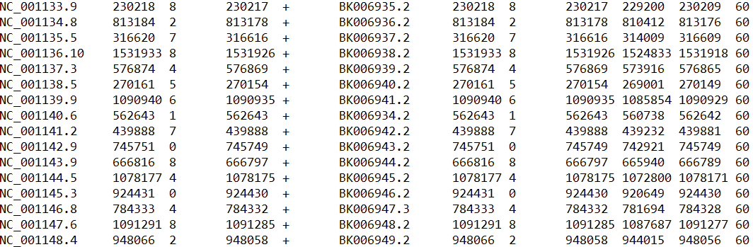
PAF format
Produced by minimap2, 0-based
If the first two bases of a read align then coordinates are (0 2)
Query Q_len Q_start Q_end Q_strand Reference R_len R_start R_end #_res bl_len MAP_Q

Slide 59
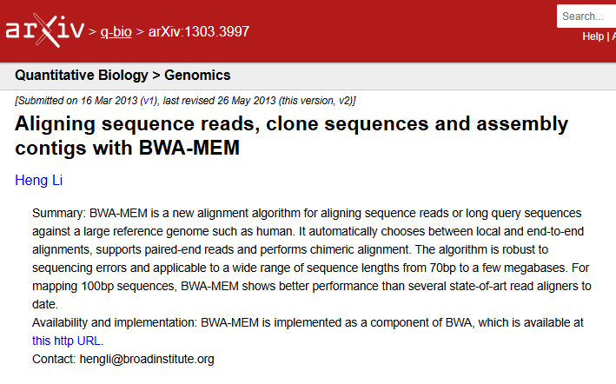
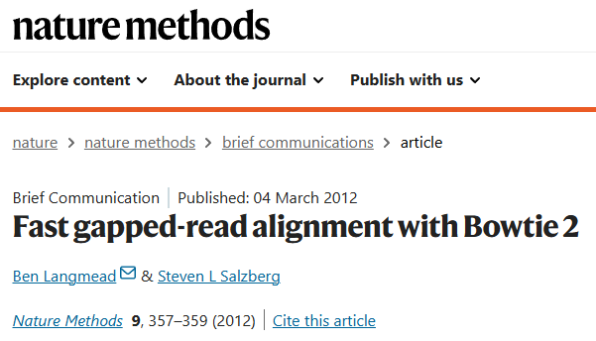
Alignment programs
Bowtie and BWA MEM
  Used for alignment of short and long reads (BWA only) to the genome
  Both based on BWT/SA

Slide 60
Alignment file formats
BED (Browser Extensible Data) – a nice format to represent alignment intervals
SAM/BAM – typically used for alignments of short reads to the genomic sequence
  BAM is the compressed version of SAM
delta/coords – typically used for alignments of two genome sequences, used by mummer package
PAF – Pairwise mApping Format, output by minimap2

Slide 61
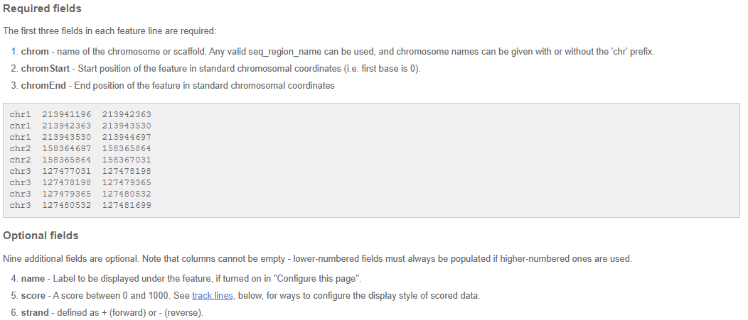
BED format
Source: https://useast.ensembl.org/info/website/upload/bed.html

Slide 62
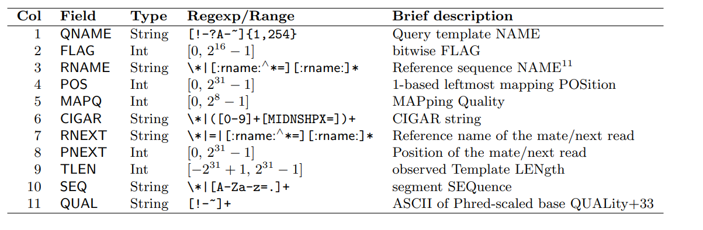
SAM format
Tab-separated file, human readable with the following columns
Missing or not defined values are *

Slide 63
SAM format
Tab-separated file, human readable with the following columns
Missing or not defined values are *

Slide 64
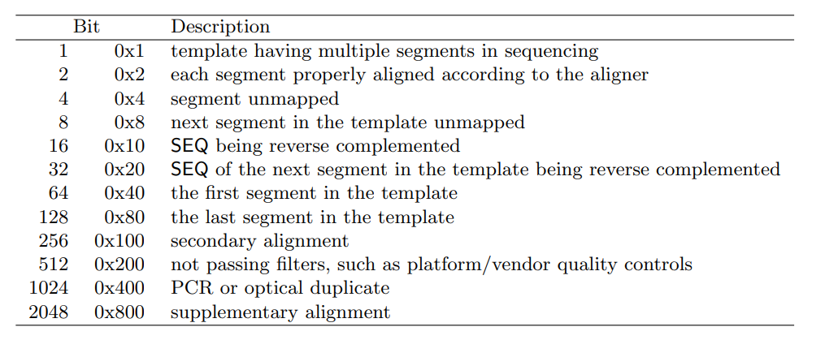
SAM format
FLAG field – 11 bits represented as decimal number
  Most often used are 0, 16, and 2064
  Conversion 000000010000₂ = 16

Slide 65
SAM format
Tab-separated file, human readable with the following columns
Missing or not defined values are *

Slide 66
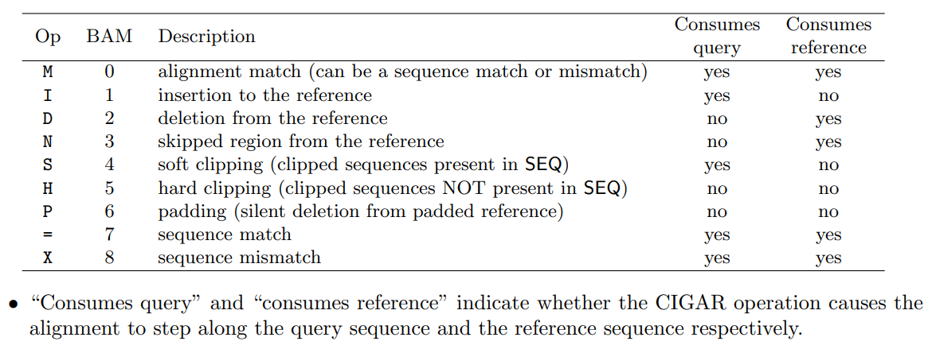
SAM format
CIGAR (Compact Idiosyncratic Gapped Alignment Report) string

Slide 67
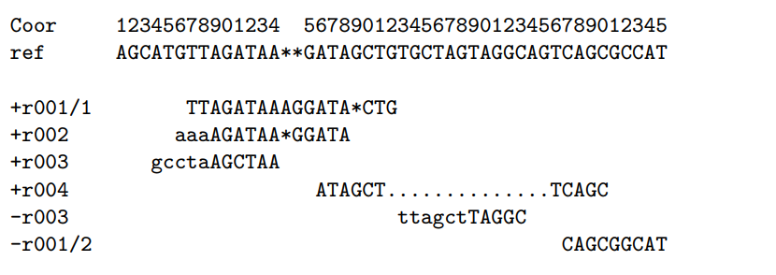
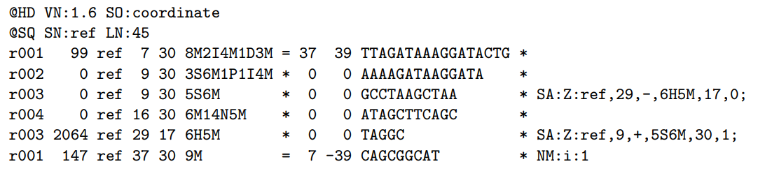
SAM format
Examples of CIGAR strings

Slide 68
SAM format https://samtools.github.io/hts-specs/SAMv1.pdf
Suppose we have the following alignment
It will look like this in the SAM file
Coordinates are 1-based

Slide 69
SAM format https://samtools.github.io/hts-specs/SAMv1.pdf
Suppose we have the following alignment
It will look like this in the SAM file
Coordinates are 1-based

Slide 70
SAM format https://samtools.github.io/hts-specs/SAMv1.pdf
Suppose we have the following alignment
It will look like this in the SAM file
Coordinates are 1-based

Slide 71
SAM format
“P” is needed to properly record full multi-alignment

Slide 72
SAM format https://samtools.github.io/hts-specs/SAMv1.pdf
Suppose we have the following alignment
It will look like this in the SAM file
Coordinates are 1-based

Slide 73
SAM format https://samtools.github.io/hts-specs/SAMv1.pdf
Suppose we have the following alignment
It will look like this in the SAM file
Coordinates are 1-based

Slide 74
SAM format https://samtools.github.io/hts-specs/SAMv1.pdf
Suppose we have the following alignment
It will look like this in the SAM file
Coordinates are 1-based

